Slide 1

Persona

Slide 2

User dimensions
People vary:
size of hands may affect the size and positioning of input buttons
motor abilities may affect the suitability of certain input and output devices
height if designing a physical kiosk
strength - a child’s toy requires little strength to operate, but greater strength to change batteries
disabilities (e.g. sight, hearing, dexterity)

Slide 3
Personas
Capture user characteristics
Capabilities, inclinations, attitude, background
Goals (not roles)
System use: novice, expert, casual, frequent
Not real people, but synthesised from real user characteristics
Should not be idealised (any disabilities?)
Bring them to life with a name, characteristics, goals, personal background
Develop multiple personas
Notes:
Novice: step-by-step (prompted), constrained, clear information
Expert: flexibility, access/power
Frequent: short cuts
Casual/infrequent: clear instructions, e.g. menu paths
is useful to make scenarios more real
Persona: rich description of typical user of the product – designers can focus on.
Goals: runner – marathon runner vs. amateur running – burning calories

Slide 4
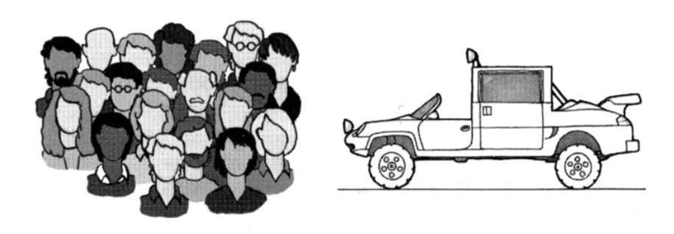
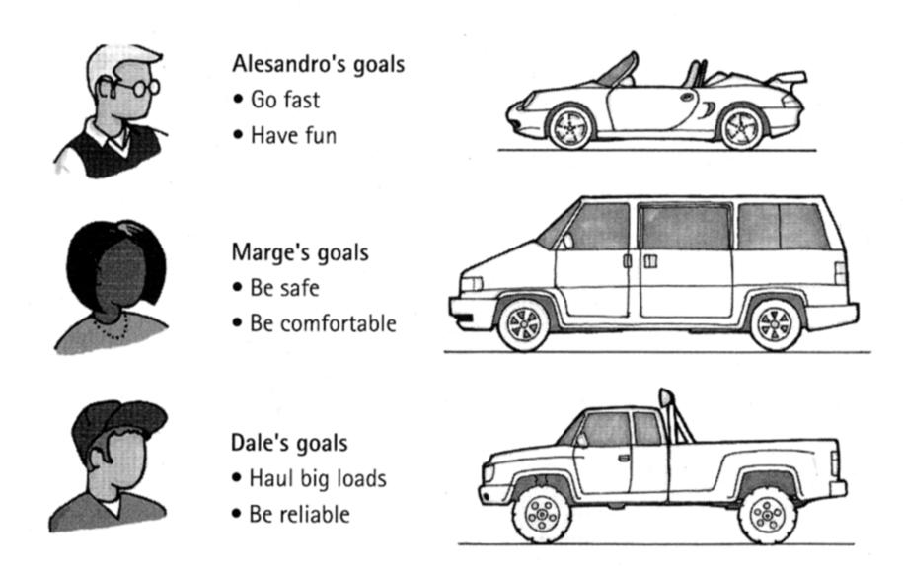
Personas
Easier to generalize about specific fictional people
We can easily discuss what Harry Potter or Frodo will think or do
General users have too
many conflicting goals
Specific personas have
clear, well-articulated goals

Slide 5
Defining and Using Personas
Defining them
Identify major clusters from multiple user interviews/inquiries
Synthesize their goals
Check for completeness and specificity
Specificity prevents “elastic user”
Try them out by developing narrative
Design each interface for a single primary persona
Yet other type might use the interface

Slide 6
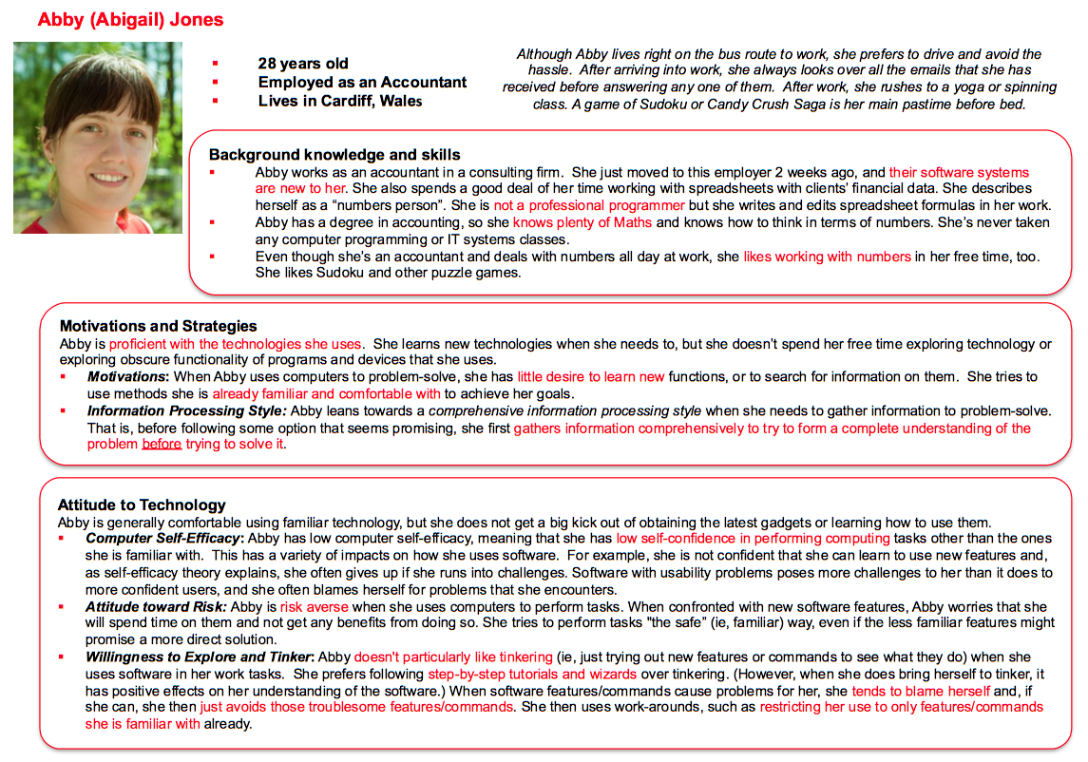
Margaret Burnett, Simone Stumpf, James MacBeth, Laura Beckwith, Stephann Makri, Irwin Kwan, and Anicia Peters, “The GenderMag Kit: How to Use the GenderMag Method to Find Usability Issues through a Gender Lens”, EUSES
Consortium, http://eusesconsortium.org/gender, Mar. 18, 2015

Slide 7
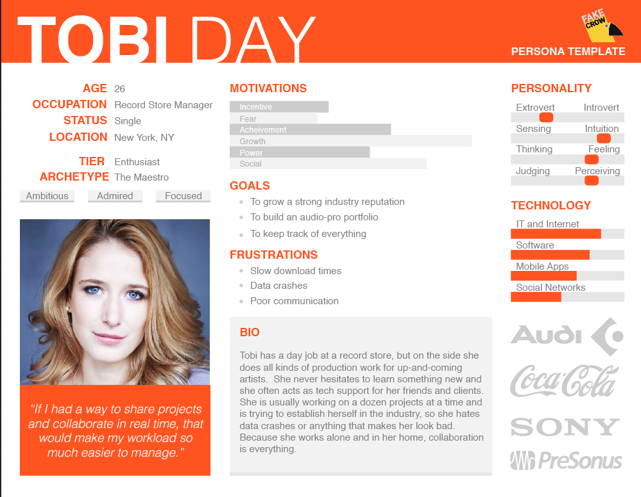
http://fakecrow.com/free-persona-template/

Slide 8
Persona for iPhone – your turn

Slide 9
